Slide 1



Mountain Bike Suspension
Team 20FB14: Austin Coyne, Dylan Klemp, Erik Abraham, Jacob Cryder, Suliman Alsinan, Tyson Spencer
Dylan Klemp

Slide 2
Project Description
Mountain bike suspension lacks the capabilities to quickly and easily adjust for different terrain on the fly and needs to have a tuning option to allow for a more comprehensive system. Mountain bike suspension can be adjusted but can sometimes be difficult to understand for the average consumer. So, the team needs to create an easier way to help even beginner mountain bikers be able to alter their suspension settings.
Dylan Klemp

Slide 3

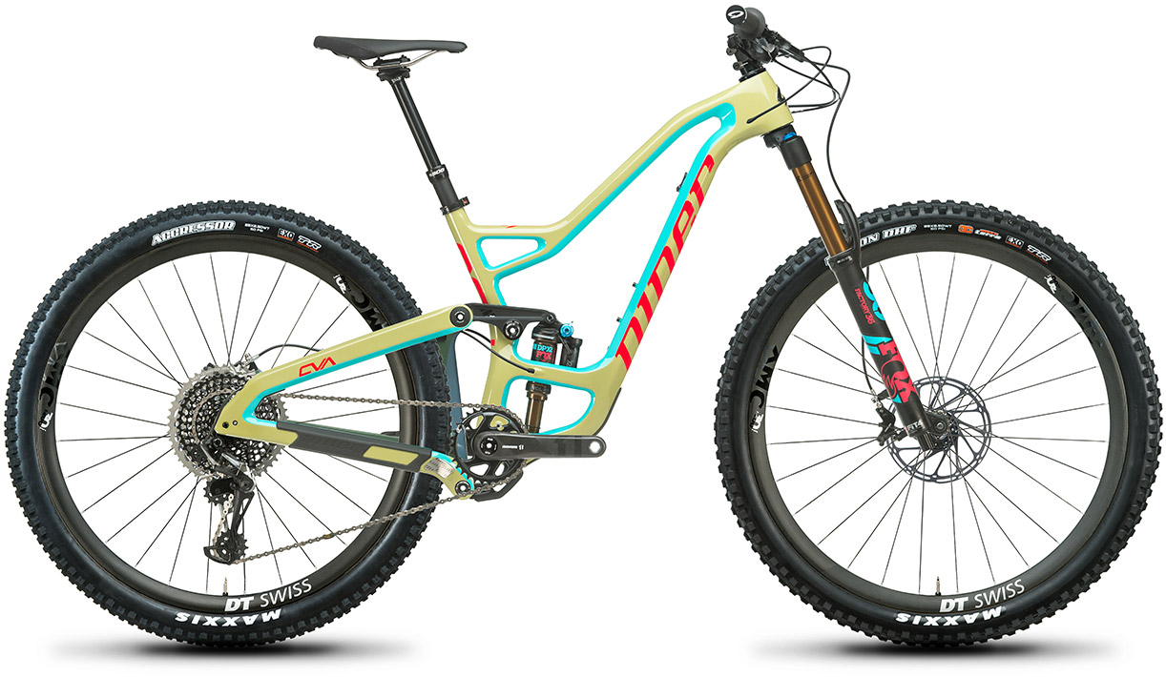

Client
Sponsors
Brandon Lurie
  Engineer at WL Gore
WL Gore
Niner Bikes
  Provided the team with a bike to use for testing
Suliman Alsinan

Slide 4
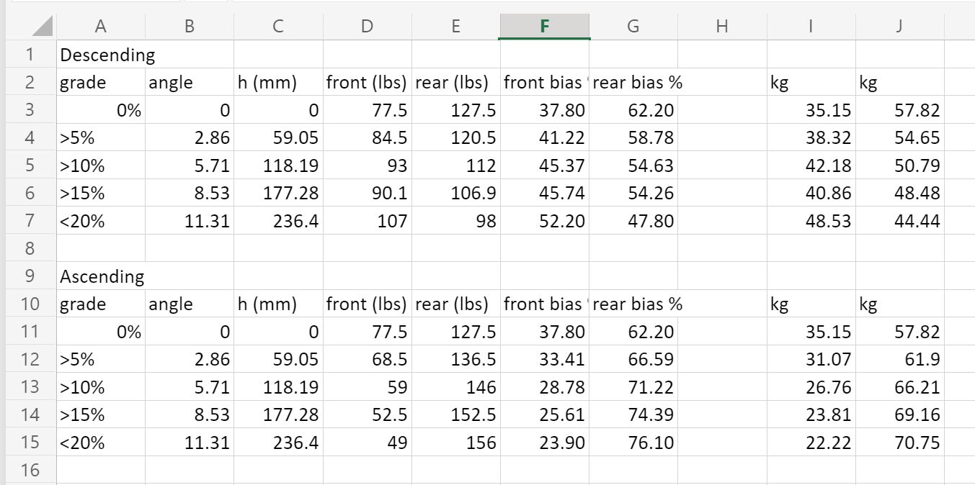
Design Description (Mathematical Model)
Input values changed from 2016 Santa Cruz Heckler to 2020 Niner Rip 9 29er.
Addition of ascending and descending weight bias data for terrain grades between 0% and 20%.
Data normalized as percentages to accommodate any change in rider weight.
Figure 1: Weight Bias Data [1]
Austin Coyne

Slide 5
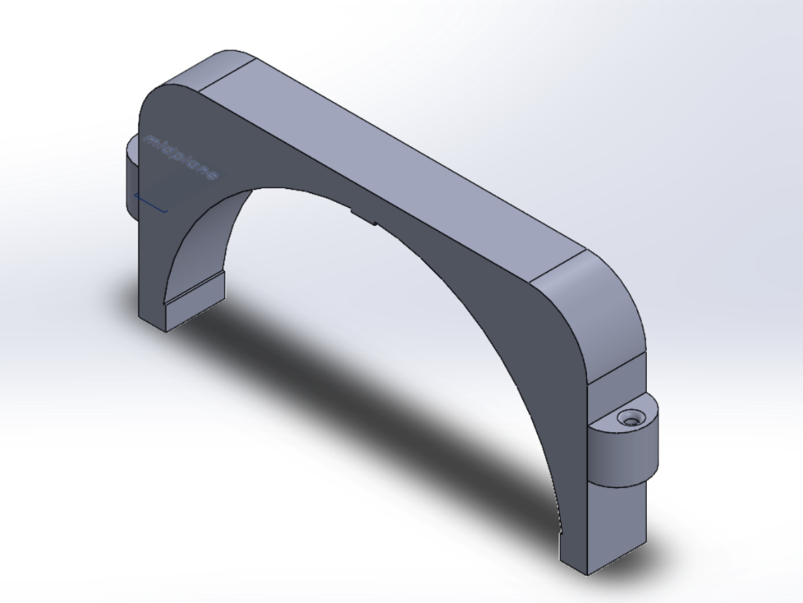
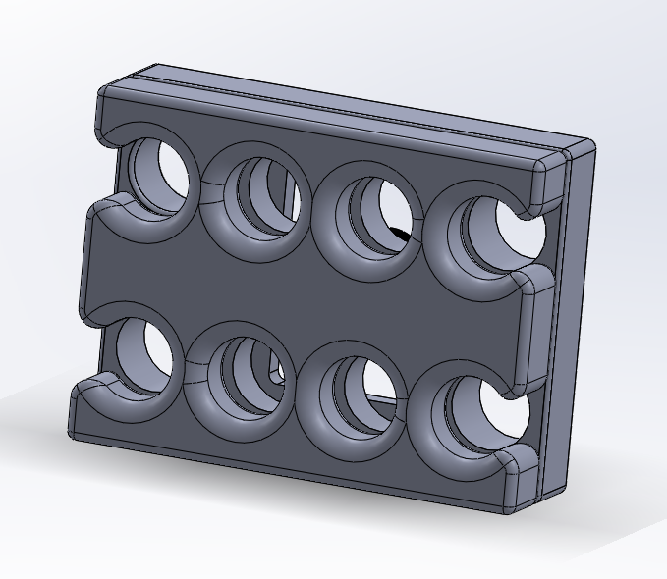
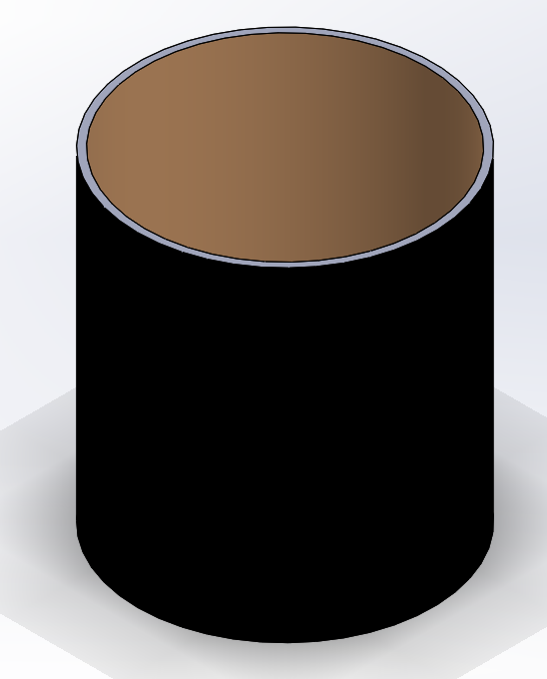
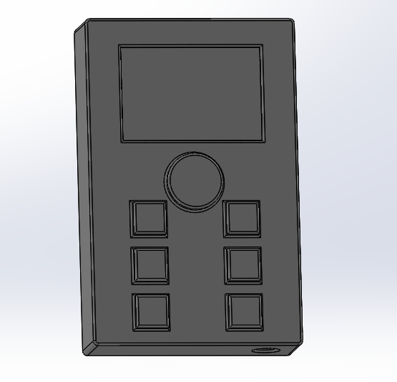
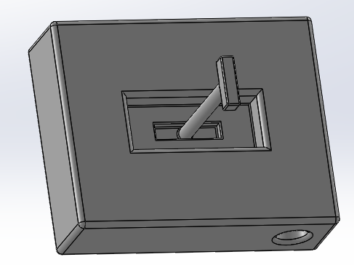
Design Description (CAD)
Figure 2: Suspension Adjustment – Knob Fork Clamp
Figure 3: Mounting Plates
Figure 4: Shim Design
Figure 5: Control Panel With buttons
Figure 6: Control Panel with Lever
Jake Cryder

Slide 6
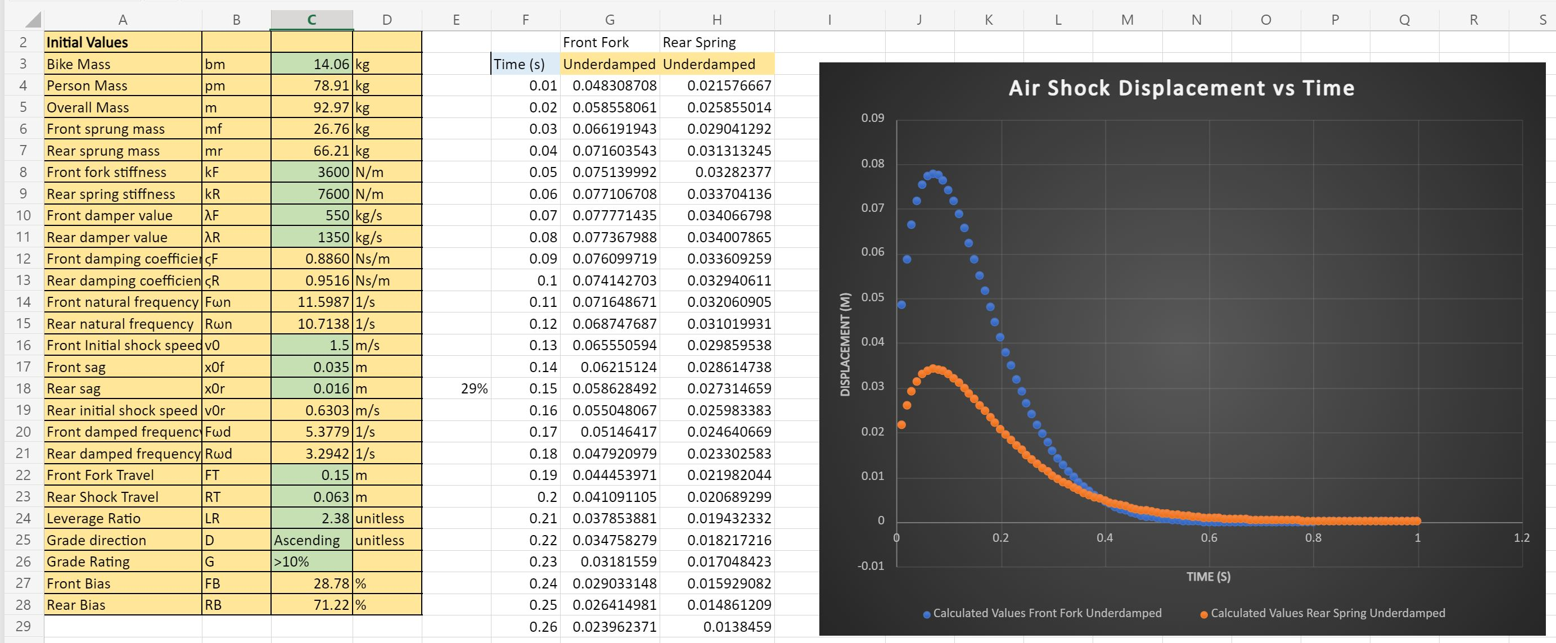
Current State of System
Figure 7: Math Model Blue Square Sheet [1]
Tyson Spencer

Slide 7
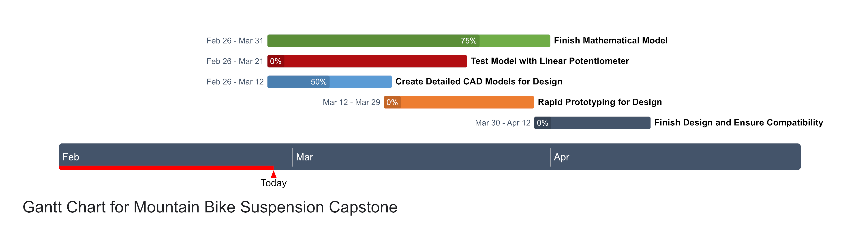
Implementation Plan
Erik Abraham

Slide 8

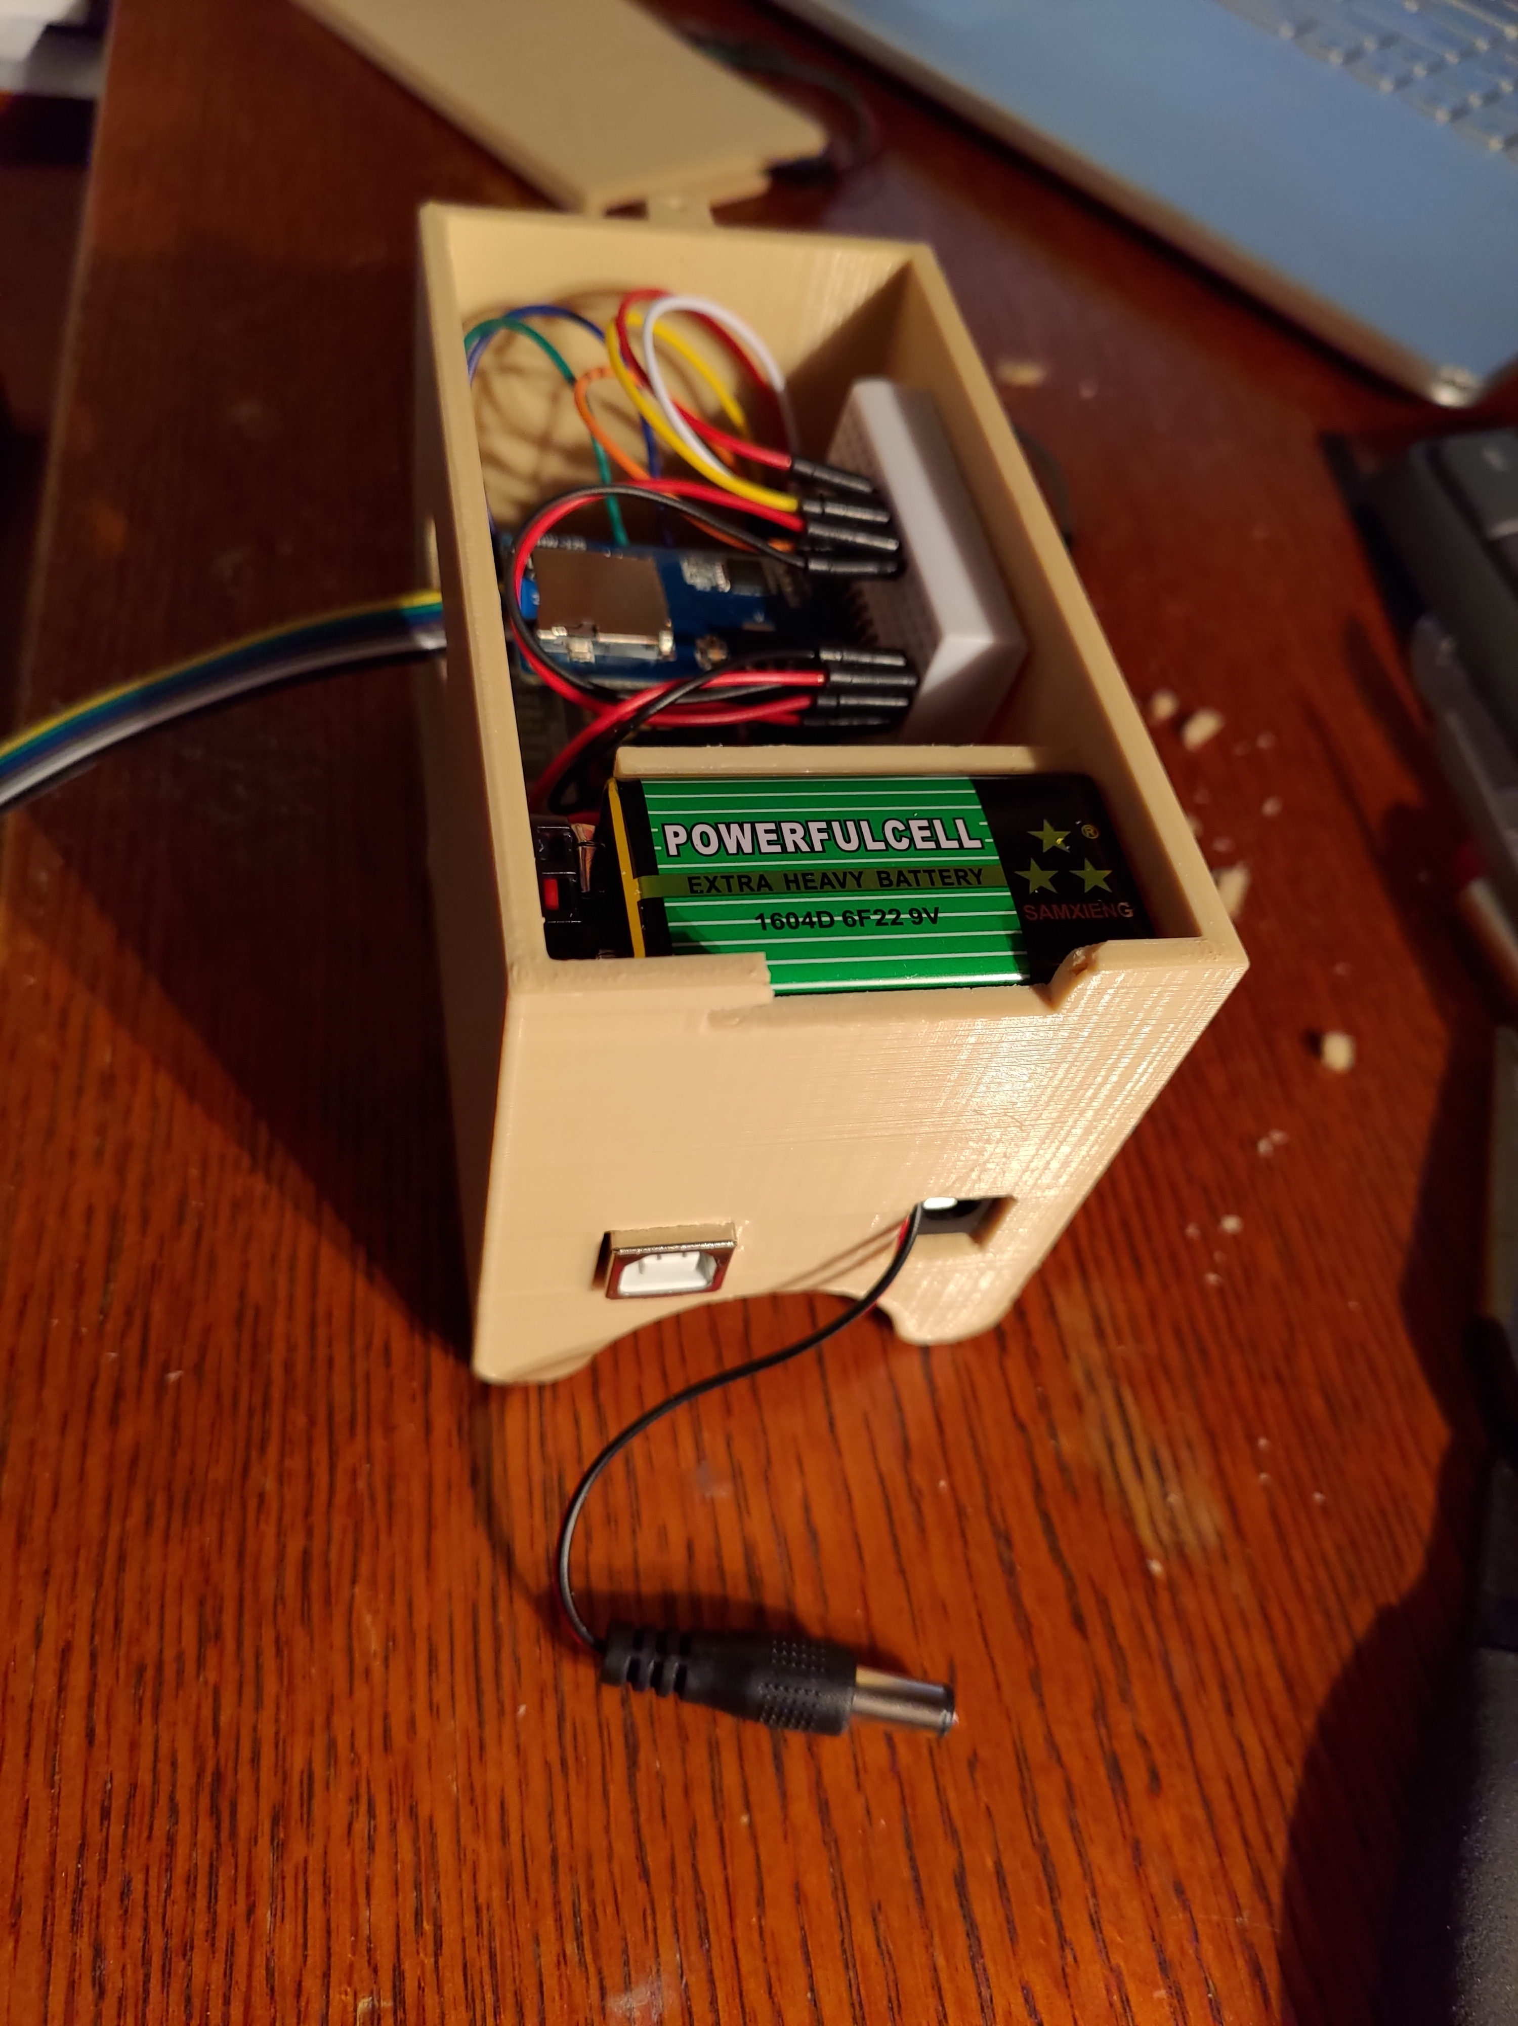
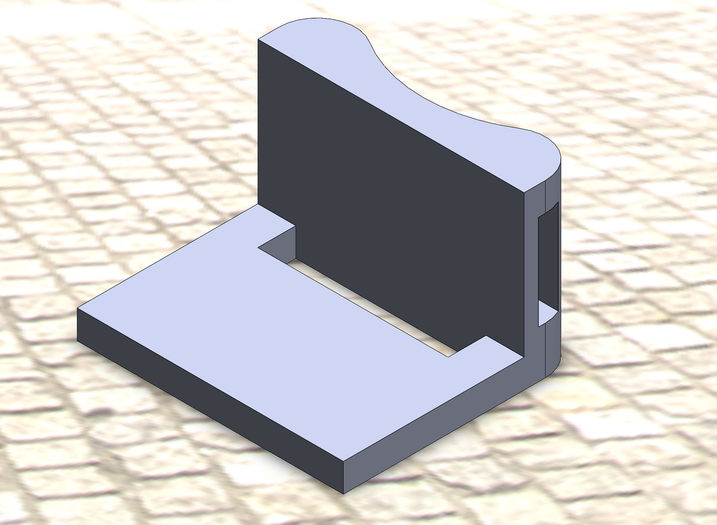
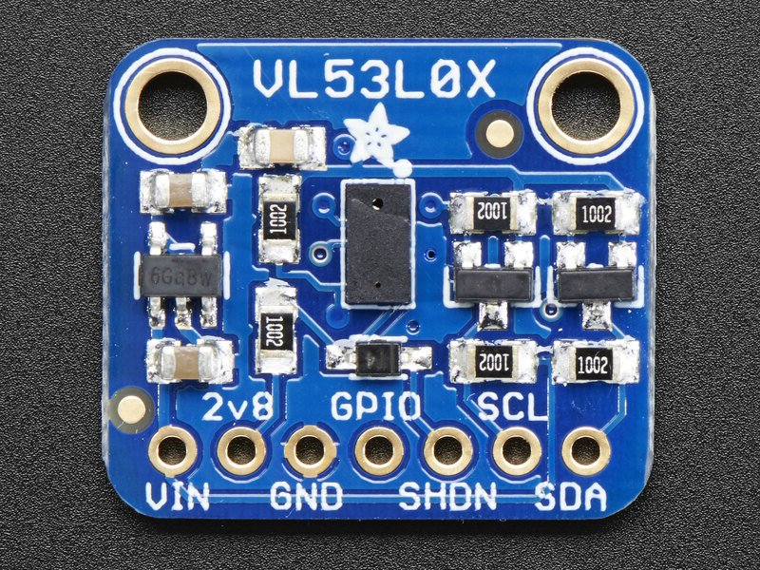
Testing Plan (Old/Backup)
Arduino Mega with LIDAR Sensor (Adafruit VL53L0X)
Measures shock travel over time to find best settings
Writes data to micro-SD card for analysis.
Tedious to implement.
Figure 9: Lidar Sensor and Bracket [2,3]
Tyson Spencer
Figure 8: Arduino Box [2]

Slide 9
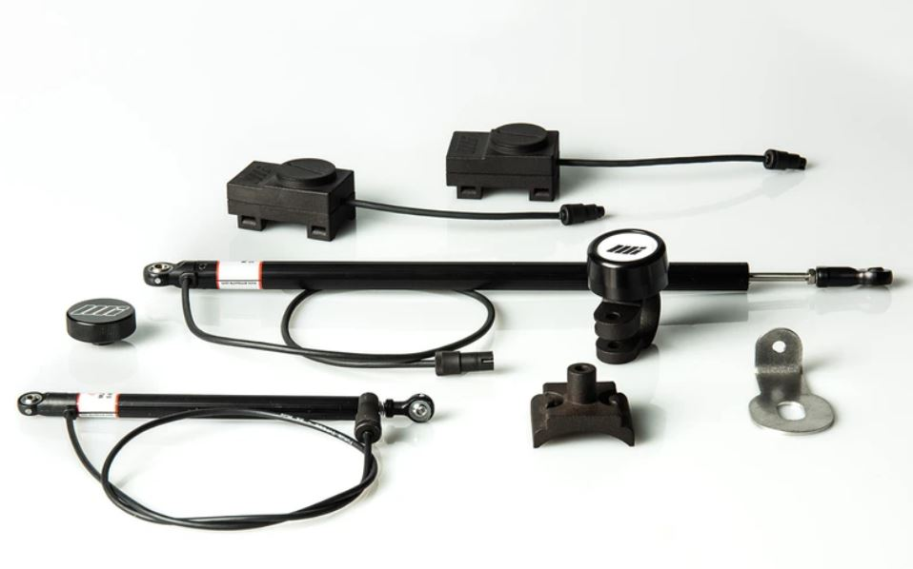
Testing Plan (New)
Motion Instruments XC-Enduro Linear Potentiometer
Set compression and rebound settings to mathematical model output
Ride over various terrain rated trails and find best settings
Adjust model based on data analysis from linear potentiometer
Figure 10: Motion Instruments XC-Enduro Pro [4]
Erik Abraham

Slide 10
Questions?

Slide 11
References
[1] E. Abraham, T. Spencer, “Updated Math Model,” Microsoft Excel, Flagstaff, 2021
[2] T. Spencer, “Arduino Pics,” Google Photos, Flagstaff, 2021
[3] T. Spencer, “Lidar Bracket,” Solidworks, Flagstaff, 2021
[4] Motion Instruments, “XC-Enduro Pro,” 2020

